Slide 1

University of Glasgow
Level 4 Dissertation Presentation
School of Computing Science
March 19, 2026
Trust-Aware Stock Trend Prediction and
Investment Strategy Optimisation
Using Deep Neural Networks
Dylan ShengHong Huang
2789356H
Supervised by Prof. Jose Joemon
Deep Learning
Financial Prediction
Risk Management

Slide 2
The Prediction Paradox
“A predicted probability of 0.7 doesn’t mean the event happens 70% of the time” – Guo et al. (2017)
Overconfidence Problem
Prediction-Allocation Gap
Deep neural networks produce miscalibrated probabilities - a predicted 70% confidence may only correspond to 50% empirical frequency. This systematic overconfidence leads to oversized positions.
Literature evaluates models on accuracy metrics alone , ignoring how predictions translate to capital allocation.
A model with 52% accuracy can be profitable or catastrophic depending on position sizing.
70%
Static Reliability
Models assume constant predictive quality across all market regimes. In reality, performance fluctuates due to volatility clustering and regime shifts—models should know when NOT to trust themselves.
Accuracy ≠ Profitability
Without calibration, reliability modeling, and principled allocation, even high-accuracy models can generate losses .
Key Insight: Financial prediction must be evaluated as a decision system , not just a classification task.

Slide 3
What Everyone Else Did
The baseline and the gap they left
StockNet (Xu & Cohen, 2018)
0.080
State-of-the-art baseline for multimodal stock prediction
MCC Score
Architecture
Data
Evaluation
Variational autoencoder with temporal attention
88 U.S. stocks, Twitter + price data (2014-2016)
Accuracy, MCC on next-day prediction
Limitations
Our Extensions
•
No probability calibration: Raw neural outputs treated as reliable probabilities
•
Probability calibration: Isotonic regression & temperature scaling
•
Meta-features: Prior errors as reliability signals
•
Static reliability: Model confidence assumed constant across regimes
•
Variable horizons: 1-day and 5-day predictions
•
Fixed horizon only: No exploration of multi-day predictions
•
Investment simulation: Full economic evaluation
•
No economic evaluation: Predictions never tested in investment simulation
•
No filtering: All trading days included
•
Dead-zone filtering: Small movements excluded, inflating accuracy

Slide 4
Our Integrated Framework
End-to-end pipeline from data to decisions
1
Multimodal Input
2
Prediction
3
Trust Layer
4
Decision Layer
Price Data
Model Architectures
Meta-Features
Allocation Strategies
OHLCV, technical indicators (EMA, MACD, RSI, Bollinger Bands)
LSTM
BiLSTM
Prior predictions & errors as reliability signals (Brier, log-loss, MAE)
Kelly: Growth-optimal sizing
GRU
BiGRU
MPT: Mean-variance optimization
Hybrid: Combined approach
Textual Features
Prediction Tasks
Calibration
BERT sentiment, emotion scores, FinBERT, stance detection
• Binary: Up/Down
Isotonic regression & temperature scaling for reliable probabilities
Early Exit
• Ordinal: Return buckets
Dynamic position liquidation when signals deteriorate
• Regression: Magnitude
Sector Context
Sector-level aggregates, cross-asset relationships
Self-Assessment
Walk-Forward
Horizons
Model learns when to trust its outputs under non-stationarity
1-day and 5-day forecasts
Realistic simulation with temporal integrity
Data flows strictly left-to-right
Temporal integrity enforced throughout
Periodic retraining in simulation

Slide 5
Meta-Features: The Secret Sauce
How prior prediction errors become features for future reliability
Feedback Loop Mechanism
Classification Meta-Features
1
Walk-Forward Prediction
Brier Score
Mean squared error of predicted probabilities
Model trained on historical window, generates out-of-sample predictions for next block
Log-Loss
2
Error Computation
Cross-entropy between predictions and outcomes
Compare predictions with realized outcomes, compute error statistics (Brier, log-loss, MAE, directional accuracy)
Directional Accuracy
Percentage of correct up/down predictions
3
Rolling Aggregation
Create lagged rolling features (20-day window) to capture recent reliability trends
Regression Meta-Features
4
Feature Augmentation
MAE / MSE
Meta-features added to base features, model learns to condition predictions on recent performance
Mean absolute and squared errors
RMSE
Root mean squared error
Directional Accuracy
Sign agreement between predicted and actual
Key Innovation: Model learns when to trust itself by conditioning on recent prediction quality, enabling adaptive behavior under non-stationarity.

Slide 6
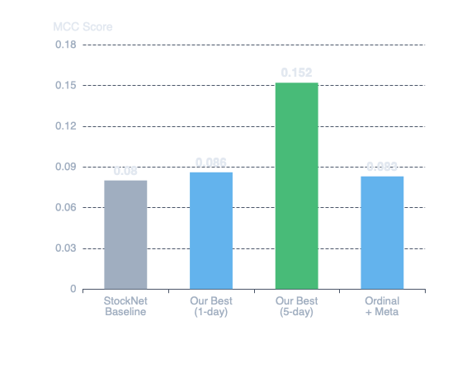
Does It Predict Better?
Predictive performance results
MCC Comparison: Our Model vs Baseline
Key Results
BiGRU (1-day)
0.086
Beats StockNet baseline
vs 0.080
5-Day Horizon
0.152
Significant improvement
vs 0.086
1-Day Ordinal + Meta
0.081
Meta-features help
vs 0.080
Model Performance Summary
Best 1-Day Binary
BiGRU + Sentiment
Best 5-Day Binary
GRU + Sector/Sent
Best 1-Day Ordinal
BiGRU + Base
Best Regression
BiLSTM + Base
Insight: Longer horizons (5-day) substantially outperform 1-day predictions, likely because short-term noise is reduced and directional structure becomes clearer.

Slide 7
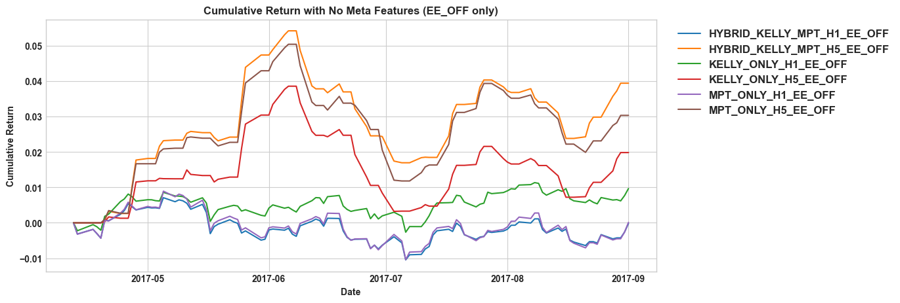
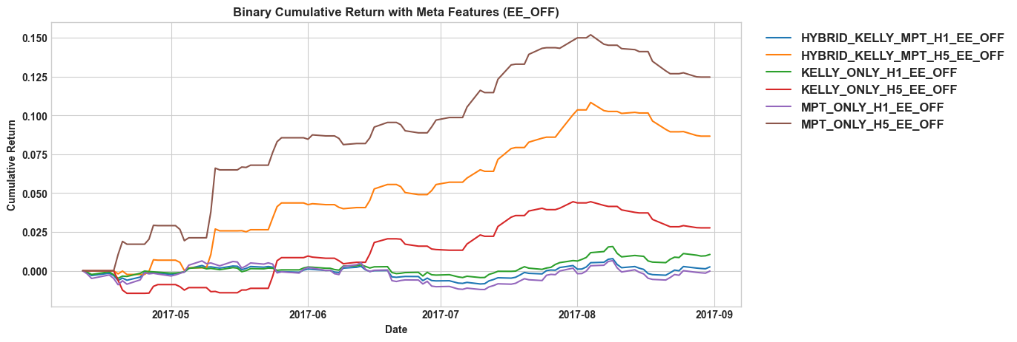
Does It Make Money?
Investment simulation results over 100 trading days
Cumulative Portfolio Returns
Meta-Features Impact
Without Meta-Features
3.94%
Kelly-only, 5-day horizon
With Meta-Features
12.47%
MPT-only, 5-day horizon
3.2× improvement with meta-features
Best Configuration
Model
BiGRU + Meta
Horizon
5-day
Allocation
MPT-only
Return
12.47%
Sharpe Ratio
4.34
Key Finding: Meta-features dramatically improve economic outcomes, with the 5-day horizon consistently outperforming 1-day predictions across all allocation strategies.

Slide 8
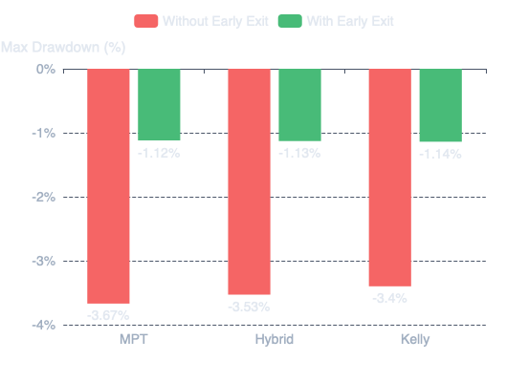
Smart Risk Management
Early exit mechanism for adaptive horizon control
Drawdown Comparison for Binary System with no Meta Features
Early Exit Mechanism
Positions are liquidated early when next-day predictions indicate deteriorating conditions. This acts as adaptive horizon control, truncating loss trajectories before they compound.
Exit Condition:
predicted_return < threshold
AND direction == down
AND confidence > 0.5
Without Early Exit
With Early Exit
-3.5%
-1.1%
Maximum Drawdown
Maximum Drawdown
68% reduction in maximum drawdown
Sharpe Improvement
Avg Early Exits/Day
Total Trades
1.51 → 4.51
3.4
424

Slide 9
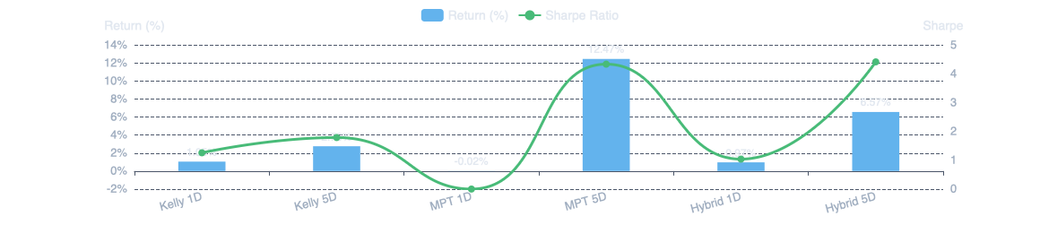
Allocation Strategy Battle
Kelly vs MPT vs Hybrid: Which wins?
Performance Comparison by Horizon Binary Simulation
Kelly
MPT
Hybrid
Wins Short-Term
Wins Long-Term
Balances Risk-Return
1-day ROI
1.05%
5-day ROI
12.47%
5-day ROI
6.57%
1-day Sharpe
1.26
5-day Sharpe
4.34
5-day Sharpe
4.42
Best For
Sparse signals
Best For
Strong signals
Best For
Balanced approach
Concentrated position sizing when opportunities are limited
Diversification across multiple assets when signal quality is high
Combines Kelly sizing with MPT diversification for optimal balance

Slide 10
Interaction Effects
How components work together as a system
Component Interactions
Negative Interactions
Calibration
+
Meta-Features
Early Exit
+
Meta
Calibration stabilizes probability inputs; meta-features improve reliability estimation. Together they produce more stable allocations.
With meta-features, early exit reduces returns (12.47% → 3.57%). Meta-features already provide reliability signals, early exit becomes redundant and may close profitable positions prematurely.
Meta-Features
+
MPT
Meta-features improve expected return estimates; MPT optimizes diversification. Best combination for 5-day horizon (12.47% return).
Meta
+
Ordinal 5D
Meta-features improve 1-day ordinal but not 5-day (10.56% → 4.86%). When base signal is already strong, meta-features may add noise rather than value.
Early Exit
+
No Meta
Early exit dramatically improves non-meta models by reducing drawdown. 68% drawdown reduction (-3.5% → -1.1%).
1-Day
+
MPT
MPT performs poorly at 1-day horizon (-0.02% return). Short-horizon signals too noisy for diversification benefits; Kelly's concentrated sizing works better.
System-Level Insight
Components cannot be evaluated in isolation. The best configuration depends on the interaction between horizon (1D vs 5D), signal type (binary vs ordinal), reliability modeling (meta vs no-meta), and allocation strategy (Kelly vs MPT vs Hybrid). Optimal performance requires matching components to signal characteristics.

Slide 11
Limitations & Future Work
Acknowledging constraints and next steps
Current Limitations
Future Research Directions
Limited Evaluation Window
Extended Evaluation
100-day simulation period is sufficient for strategy comparison but insufficient for robustness claims across multiple market regimes (bull, bear, high volatility).
Test across multiple years and market regimes to validate robustness, especially for meta-features and allocation behavior under changing volatility.
Richer Text Sources
Sparse Textual Data
Incorporate news headlines, earnings transcripts, filtered social media weighted by source reliability and engagement metrics.
Tweet activity is not uniform across all days, requiring neutral filling. This may weaken the textual signal and explain inconsistent gains from NLP features.
Explicit Regime Detection
Search Budget Constraints
Explore uncertainty-aware architectures that directly model predictive reliability rather than learning through auxiliary features.
Meta-feature experiments used same 100 Optuna trials despite significantly larger search space. Some configurations may be undertuned.
Reinforcement Learning
Simplified Frictions
Treat as continuously adaptive decision process with RL for dynamic allocation, online calibration, and regime-dependent model selection.
No explicit modeling of market impact, slippage, or execution latency. Results represent realistic simulations rather than evidence of immediate deployability.

Slide 12

Key Takeaway
Financial prediction must be evaluated as a
decision system, not a classification task
Integrated Framework
Economic Outcomes
Trust-Aware Design
Bridged prediction and investment through calibration, meta-features, and principled allocation
12.47% return with Sharpe 4.34, demonstrating practical value beyond accuracy metrics
Models learn when to trust themselves through meta-features and reliability modeling
Best MCC
Best Return
Drawdown Reduction
0.086 → 0.152
12.47%
-3.5% → -1.1%
1-day to 5-day
MPT + Meta 5D
With early exit
Thank you for your attention
Questions?

